Slide 1


Strategic Sellers’ Assessment Meeting
www.ValueBuilder.com copyright 2020

Slide 2
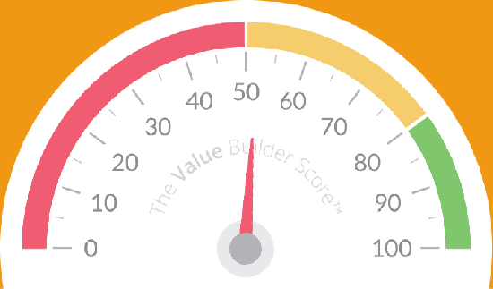


Prepared for: Gerry Graham
Prepared by: Elana Butot
Date: 02/22/2020
Notes:
Thanks for sharing your goal on our last call that you want to sell in the next five years. Thanks also for completing your Value Builder questionnaire -- that's super helpful for us. We’re in the midst of preparing your Value Builder report, along with your estimate of value and to make that as meaningful as possible, I’d like to dig into a few of your answers to the questions we posed.

Slide 3
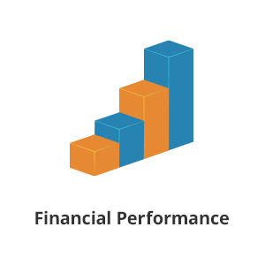


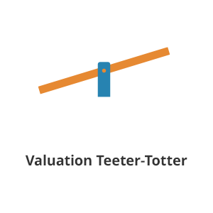
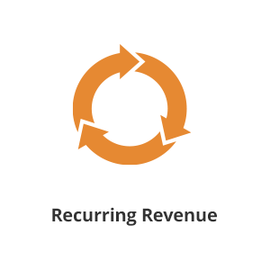
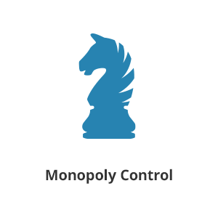
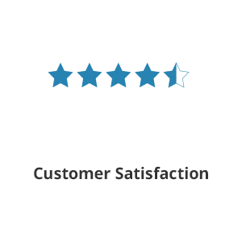

The 8 Key Drivers
Your Value Builder Score is calculated through an analysis of your business’s performance on eight factors that drive the value of your business. Along with your score, you will see a result on all eight of the value drivers and the average score for each among companies in your industry.
Your history of producing revenue and profit combined with the professionalism of your record keeping.
Your likelihood to grow your business in the future and at what rate.
How dependent your business is on any one employee, customer or supplier.
Whether your business is a cash suck or a cash spigot.
The proportion and quality of automatic, annuity-based revenue you collect each month.
How well differentiated your business is from competitors in your industry.
The likelihood that your customers will re-purchase and also refer you.
How your business would perform if you were unexpectedly unable to work for a period of three months.
Notes:
Your Value Builder Report includes an individual score on each of eight factors and today I want to focus on two: your best result and the factor where there’s the biggest opportunity for growth.

Slide 4

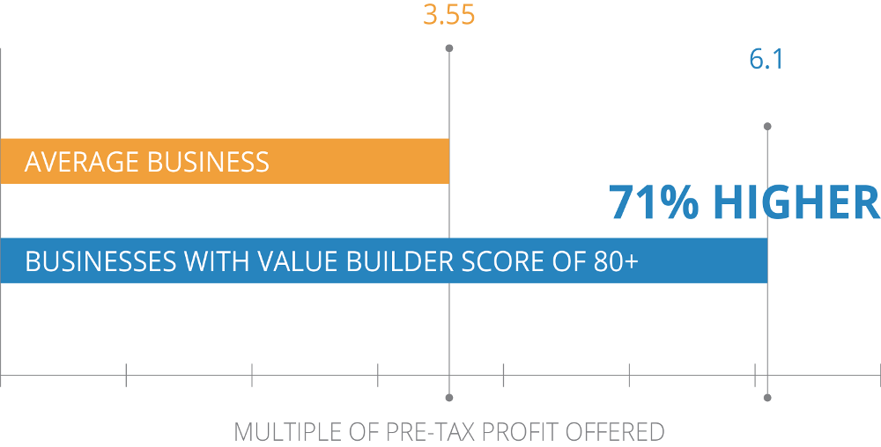
Overall Score
The Value Builder Premium
The Value Builder Score gives you a comprehensive assessment of the "sellability" of your business, whether you want to sell next year or just know you're building a valuable asset for the future.
Through an analysis of tens of thousands of businesses, we’ve discovered that companies that achieve a Value Builder Score of 80+ out of a possible 100 receive offers to buy their business that are 71% higher than what the average company receives.
Your overall score reflects your performance on the eight key drivers, which are statistically proven to improve the value of your company.
◆ Score: 52
Notes:
As a reminder, everyone who starts with us begins their journey by getting their Value Builder Score. Across our company, we’ve worked with more than fifty thousand business owners and the average score is between fifty and sixty on a scale of zero to one hundred.
At an overall score of fifty two, you’re right in the range of most owners when they begin working with us. To understand the relationship between your score and the value of your business, we can simply look at the acquisition offers our customers receive. Our average owner starting the program with a score between 50 and 60 has received an acquisition offer of three point five times pre tax profit. For those owners who get their score up to 80, they’re getting offers that are almost double. Given you goal to exit in five years, we’ve got lots of time and I think we can make a big impact on your take from a sale. Your Value Builder Score is made up of your results on eight unique factors that are important to acquirers.

Slide 5

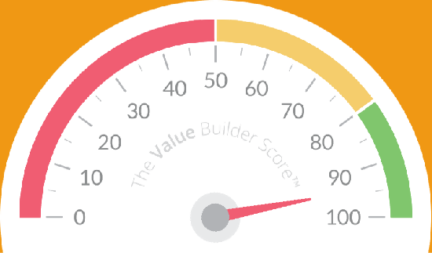

Driver 7
The Customer Score
◆ Score: 94
The likelihood that your customers will
re-purchase and also refer you.
Notes:
One of those factors is called “The Customer Score” and it’s a measure of your customer’s overall satisfaction. As you can imagine, an acquirer will be curious to know if your customers are happy and on this measure, you’re hitting it out of the park: 94 out of a possible 100…

Slide 6

“Please estimate the percentage of your customers who are VERY SATISFIED with the services/products which your company provides:”
The Customer Score
Less than 25% of our customers are “very satisfied”
25%-50% of our customers are “very satisfied”
51-75% % of our customers are “very satisfied”
More than 75% of our customers are "very satisfied" – your answer
I’m not sure - we don’t measure customer satisfaction
The likelihood that your customers will
re-purchase and also refer you.
Action Items
◆ Score: 94
1.
2.
3.
Notes:
You got the maximum number of points for the question pertaining to the proportion of your customers who are very satisfied.

Slide 7
The Customer Score
“How often, if at all, do your existing customers refer your company to their friends and colleagues:”
Always – your answer
Sometimes
Rarely
Never
Unsure
The likelihood that your customers will
re-purchase and also refer you.
Action Items
◆ Score: 94
1.
2.
3.
Notes:
You also got top marks for the question that relates to how often your customers refer you.

Slide 8
The Customer Score
“In the last 12 months, what proportion of your customers complained in writing (e.g. email, letter, submission to your website)?”
None + <1 point
Less than 1% – your answer
1-5%
5-10%
More than 10%
The likelihood that your customers will
re-purchase and also refer you.
Action Items
◆ Score: 94
1.
2.
3.
Notes:
You got the second best score on the question that relates to the proportion of your customers who complain. The ideal response to this question is none and you answered less than one percent which is still very good indeed.
You are absolutely crushing it when it comes to the satisfaction of your customers – what do you attribute your success to in this area?

Slide 9

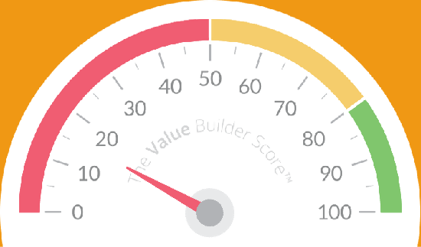
Driver 8
Hub & Spoke
How your business would perform if you were unexpectedly unable to work for a period of three months.
◆ Score: 16
Notes:
Another attribute that will be important to acquirers is something called Hub & Spoke which measure your company’s reliance on you personally. It’s very normal for a successful owner with a customer-centric business like yours to have a lower score on this measure which doesn’t concern me because we’ve got five years to improve this attribute.

Slide 10
Hub & Spoke
“What percentage of your company's revenue (i.e. sales / turnover) is undertaken personally by you or your fellow equity holders?”
None + 1 point
1-25%
26-50%
51-75% – your answer
76-100%
Unsure
How your business would perform if you were unexpectedly unable to work for a period of three months.
Action Items
◆ Score: 16
1.
2.
3.
Notes:
Your Hub & Spoke score is driven by a few questions. This question asked what percentage of your company’s revenue are you responsible for. Your answer was fifty to seventy five percent and you can see the ideal answer -- “none” -- appears in green.
Can you tell me a little but more about how you win customers today?
What’s your role in the selling process?
What would have to happen to get others doing some of the selling?

Slide 11
Hub & Spoke
“Which of the following best describes your management team?”
We don't have one. – your answer
We have a couple of senior people who act as informal leaders, but their leadership roles are not clearly defined.
We have managers in charge of sales/marketing and producing our services/products.
We have a management team in place, and they have a compensation package that provides a long-term financial incentive to stay with our company (i.e., more than an annual bonus). + 6 points
How your business would perform if you were unexpectedly unable to work for a period of three months.
Action Items
◆ Score: 16
1.
2.
3.
Notes:
Another attribute acquirers will care about is the extent to which you’ve built a management team. They know you’ll be riding off into the sunset wo it will be important to show an acquirer your company has a management team in place. It looks like this is not something you’ve started yet so there’s an opportunity to gain a lot of points by setting up a management team. Is building a management team something you’ve considered in the past?
What are some of the obstacles you’ve run into?
What would have to happen to be able to set up one up?

Slide 12
Hub & Spoke
“Which of the following best describes your personal relationship with your company's customers?”
I know each of my customers by first name and they expect that I personally get involved when they buy from my company. – your answer
I know most of my customers by first name and they usually want to deal with me rather than one of my employees.
I know some of my customers by first name and a few of them prefer to deal with me rather than one of my employees.
I don’t know my customers personally and rarely get involved in serving an individual customer. + 2 points
Unsure
How your business would perform if you were unexpectedly unable to work for a period of three months.
Action Items
◆ Score: 16
1.
2.
3.
Notes:
Another area of Hub & Spoke relates to your personal relationship with your customers. Here’s where these value drivers actually compete with one another. It’s very common for companies that score really high on customer satisfaction score lower on Hub & Spoke because the owner is managing many of the customers. You can see the idea would be to get to a situation where you’re no longer personally managing any customer relationships.
What would have to happen to make that possible?
What changes would you need to make to your business model?
What changes would you need to make to your staff and their training?

Slide 13
Hub & Spoke
“How would your business perform if you were out of action for 3 months and unable to work? Would it:”
Hardly suffer at all, and survive + 6 points
Suffer a little, but survive
Suffer a lot, but survive
Suffer a lot, and not survive – your answer
Unsure
How your business would perform if you were unexpectedly unable to work for a period of three months.
Action Items
◆ Score: 16
1.
2.
3.
Notes:
The final question that roles up under Hub & Spoke relates to how well your company would do if you were out for a while. You can see the ideal answer in green is that your company would hardly suffer in your absence. Your response suggests you being out for an extended period would be a challenge – what would have to happen for you to get the business to a place where you could leave for a few months and everything would keep humming along?
What would be the first thing to break down if you were away?
what could you do to minimize the likelihood of that kind of disruption?

Slide 14

Proud Parents Assessment Meeting
www.ValueBuilder.com copyright 2020

Slide 15
Prepared for: Gerry Graham
Prepared by: Elana Butot
Date: 02/22/2020
Notes:
It was great to learn a little more about your goals last time. I think it would be an amazing accomplishment to be able to take a sabbatical in Europe while your business keeps humming.
I wanted you to take your Value Builder questionnaire because it helps us evaluate how an acquirer would look at your business. Acquirers invest in businesses that can thrive without their owner so the very same things that will make your business valuable to an investor are what we need to focus on to enable you to take that sabbatical.
We’re in the midst of preparing your Value Builder report and I’d like to dig into a few of your answers to the questions we posed.

Slide 16
The 8 Key Drivers
Your Value Builder Score is calculated through an analysis of your business’s performance on eight factors that drive the value of your business. Along with your score, you will see a result on all eight of the value drivers and the average score for each among companies in your industry.
Your history of producing revenue and profit combined with the professionalism of your record keeping.
Your likelihood to grow your business in the future and at what rate.
How dependent your business is on any one employee, customer or supplier.
Whether your business is a cash suck or a cash spigot.
The proportion and quality of automatic, annuity-based revenue you collect each month.
How well differentiated your business is from competitors in your industry.
The likelihood that your customers will re-purchase and also refer you.
How your business would perform if you were unexpectedly unable to work for a period of three months.
Notes:
Your Value Builder Report includes an individual score on each of eight factors and today I want to focus on two: your best result and the factor where there’s the biggest opportunity for growth.

Slide 17
Overall Score
The Value Builder Premium
The Value Builder Score gives you a comprehensive assessment of the "sellability" of your business, whether you want to sell next year or just know you're building a valuable asset for the future.
Through an analysis of tens of thousands of businesses, we’ve discovered that companies that achieve a Value Builder Score of 80+ out of a possible 100 receive offers to buy their business that are 71% higher than what the average company receives.
Your overall score reflects your performance on the eight key drivers, which are statistically proven to improve the value of your company.
◆ Score: 52
Notes:
As a reminder, everyone who starts with us begins their journey by getting their Value Builder Score. Across our company, we’ve worked with more than fifty thousand business owners and the average score is between fifty and sixty on a scale of zero to one hundred.
At an overall score of fifty two, you’re right in the mid range of most owners when they begin working with us.
A business achieving a score of 80 or more can thrive without its owner which is why acquirers pay a 71% premium over our average-scoring business. I know your goal is not necessarily to sell, but getting your score up to 80 or better will enable you to have a stress free sabbatical and you can rest easy knowing you’re building a valuable asset for whenever you do decide to exit. Your overall score is derived from your score on eight unique factors….

Slide 18
Driver 7
The Customer Score
◆ Score: 94
The likelihood that your customers will
re-purchase and also refer you.
Notes:
One of those factors is called “The Customer Score” and it’s a measure of your customer’s overall satisfaction. As you can imagine, an acquirer will be curious to know if your customers are happy and satisfied customers are a prerequisite for a stress free sabbatical. By any measure, you’re hitting it out of the park: 94 out of a possible 100…

Slide 19
“Please estimate the percentage of your customers who are VERY SATISFIED with the services/products which your company provides:”
The Customer Score
Less than 25% of our customers are “very satisfied”
25%-50% of our customers are “very satisfied”
51-75% % of our customers are “very satisfied”
More than 75% of our customers are "very satisfied" – your answer
I’m not sure - we don’t measure customer satisfaction
The likelihood that your customers will
re-purchase and also refer you.
Action Items
◆ Score: 94
1.
2.
3.
Notes:
You got the maximum number of points for the question pertaining to the proportion of your customers who are very satisfied.

Slide 20
The Customer Score
“How often, if at all, do your existing customers refer your company to their friends and colleagues:”
Always – your answer
Sometimes
Rarely
Never
Unsure
The likelihood that your customers will
re-purchase and also refer you.
Action Items
◆ Score: 94
1.
2.
3.
Notes:
You also got top marks for the question that relates to how often your customers refer you.

Slide 21
The Customer Score
“In the last 12 months, what proportion of your customers complained in writing (e.g. email, letter, submission to your website)?”
None + <1 point
Less than 1% – your answer
1-5%
5-10%
More than 10%
The likelihood that your customers will
re-purchase and also refer you.
Action Items
◆ Score: 94
1.
2.
3.
Notes:
You got the second best score on the question that relates to the proportion of your customers who complain. The ideal response to this question is none and you answered less than one percent which is still very good indeed.
You are absolutely crushing it when it comes to the satisfaction of your customers – what do you attribute your success to in this area?

Slide 22
Driver 8
Hub & Spoke
How your business would perform if you were unexpectedly unable to work for a period of three months.
◆ Score: 16
Notes:
Hub & Spoke measures your company’s reliance on you personally. It’s very normal for a successful owner with a customer-centric business like yours to have a lower score on this measure which doesn’t concern me because we’ve got five years to improve this attribute.

Slide 23
Hub & Spoke
“What percentage of your company's revenue (i.e. sales / turnover) is undertaken personally by you or your fellow equity holders?”
None + 1 point
1-25%
26-50%
51-75% – your answer
76-100%
Unsure
How your business would perform if you were unexpectedly unable to work for a period of three months.
Action Items
◆ Score: 16
1.
2.
3.
Notes:
Your Hub & Spoke score is driven from a few questions. This question asked what percentage of your company’s revenue are you responsible for? Your answer was fifty to seventy five percent and you can see the ideal answer -- “none” -- appears in green.
Can you tell me a little but more about how you win customers today?
What’s your role in the selling process?
What would have to happen to get others doing some of the selling?

Slide 24
Hub & Spoke
“Which of the following best describes your management team?”
We don't have one. – your answer
We have a couple of senior people who act as informal leaders, but their leadership roles are not clearly defined.
We have managers in charge of sales/marketing and producing our services/products.
We have a management team in place, and they have a compensation package that provides a long-term financial incentive to stay with our company (i.e., more than an annual bonus). + 6 points
How your business would perform if you were unexpectedly unable to work for a period of three months.
Action Items
◆ Score: 16
1.
2.
3.
Notes:
Another requirement for a guilt-free sabbatical is a management team that can handle the day-to-day aspects of running your company. It looks like this is not something you’ve started yet…
Is building a management team something you’ve considered in the past?
What are some of the obstacles you’ve run into?
What would have to happen to be able to set up one up?

Slide 25
Hub & Spoke
“Which of the following best describes your personal relationship with your company's customers?”
I know each of my customers by first name and they expect that I personally get involved when they buy from my company. – your answer
I know most of my customers by first name and they usually want to deal with me rather than one of my employees.
I know some of my customers by first name and a few of them prefer to deal with me rather than one of my employees.
I don’t know my customers personally and rarely get involved in serving an individual customer. + 2 points
Unsure
How your business would perform if you were unexpectedly unable to work for a period of three months.
Action Items
◆ Score: 16
1.
2.
3.
Notes:
Another area of Hub & Spoke relates to your personal relationship with your customers. Here’s where these value drivers actually compete with one another. It’s very common for companies that score really high on customer satisfaction to score lower on Hub & Spoke because the owner is managing many of the customers. You can see the ideal would be if you were no longer personally managing any customer relationships.
What would have to happen to make that possible?
What changes would you need to make to your business model?
What changes would you need to make to your staff and their training?

Slide 26
Hub & Spoke
“How would your business perform if you were out of action for 3 months and unable to work? Would it:”
Hardly suffer at all, and survive + 6 points
Suffer a little, but survive
Suffer a lot, but survive
Suffer a lot, and not survive – your answer
Unsure
How your business would perform if you were unexpectedly unable to work for a period of three months.
Action Items
◆ Score: 16
1.
2.
3.
Notes:
The final question that roles up under Hub & Spoke relates to how well your company would do if you were out for a while – we really need to nail this for you to enjoy your sabbatical.
You can see the ideal answer in green is that your company would hardly suffer in your absence. Your response suggests you being out for an extended period would be a challenge.
what would have to happen for you to get the business to a place where you could leave for a few months and everything would keep humming along?
What would be the first thing to break down if you were away?
What could you do to minimize the likelihood of that kind of disruption?
What systems would you need to create to allow your business to run without you?
What kind of employee training have you considered?
What do you do today could be automated by leveraging technology?

